Slide 1
Childhood Disability Benefits (SSI): Ensuring Support for Children in Poverty
Rebecca Steinhauser
Managing Attorney
Advocates for Basic Legal Equality, Inc.
January 13, 2025

Slide 2
Poverty & Health
Poverty causes poor health
People with a higher socioeconomic status have better health outcomes.
“Psychological, social and economic adversity in childhood can have long-term consequences for health.”
Benedict, Meredith et. al., Social Determinants of Health Disparities and the Role of Law, Poverty Health and Law, 2011.

Slide 3
Poor Health Causes Poverty
Medical conditions, disabilities, and overall poor health affect ability to maintain employment and manage expenses
In 2022, 66% of bankruptcies filed were filed due to medical issues
Ohio access basics, Health Policy Institute of Ohio, October 2012

Slide 4
Wide Range of Factors Influence Child Health
Child and Family Health
Stability & Safety
Housing & Utilities
Food
Healthcare Access
Employment & Income
School Discipline & Special Education
Immigrant Status

Slide 5
Supplemental Security Income
SSI (title XVI) provides for SSI payments to individuals, including children under age 18, who are disabled and have limited income and resources.

Slide 6
Supplemental Security Income (SSI)
A minimum monthly check paid to low-income aged, blind and disabled people.
The maximum monthly benefit in 2025 is $967
The resource limit is $2,000 For child living with one parent and $3000 for child living with two parents .
Benefit amount can vary depending on living situation

Slide 7
Purpose of Child SSI: Where does SSI fit in?
To assure a minimum level of income for children who are blind or disabled and who do not have sufficient income and resources to maintain a standard of living.
Financial support to children in poverty when their disability may require that they receive additional supports, supervision, care. (i.e. Parent may not be able to maintain work due to child’s needs.)

Slide 8
Medical Eligibility Standard
Meets SSA Definition of Disability:
Adult applying for SSDI or SSI: “inability to engage in any substantial gainful activity by reason of any medically determinable physical or mental impairment(s) which can be expected to result in death or … has lasted or can be expected to last for a continuous period of not less than 12 months.” ( Some claims are screened out due to failure to meet the 12-month requirement.)
Child < 18 yrs applying for SSI: “has a medically determinable physical or mental impairment or combination of impairments that causes marked and severe functional limitations, and…can be expected to cause death or … has lasted or can be expected to last for a continuous period of not less than 12 months.

Slide 9
Step 1: Substantial Gainful Activity?
Substantial = perform significant physical or mental duties productive in nature.
Gainful = work usually done for pay or profit, whether or not it's realized, licit or illicit.
Significant duties = have a degree of economic value.
Set by SSA, applied nationally, updated yearly: gross monthly wages of $1620 if not blind, $2700 if blind in 2025.
Individuals working at Substantial Gainful Level (SGA) are “not disabled”. (There are some exceptions)

Slide 10
Step 2: Severe Impairment
A medically determinable impairment that is more than a slight abnormality
Must cause more than minimal functional limitations

Slide 11
Step 3: Children’s SSI Process
Impairment must meet a listing OR
Impairment must medically equal a listing OR
Impairment must functionally equal a listing

Slide 12
Step 3 (continued): Meets or Equals a Listing
What is a Medical Listing?
Impairment listed in Disability Evaluation Under Social Security (“The Blue Book”)
www.socialsecurity.gov/disability/professionals/bluebook/index.htm
Listings describe medical criteria for the most severe impairments in 14 body systems; separate Listings for adults and children.

Slide 13
Step 3 (continued): Meets or Equals a Listing
Medical documentation of these criteria can result in an allowance without consideration of the individual’s limitations – except for mental impairments. (Functional analysis is still required for mental impairments.)

Slide 14
Functional Equivalence
Child’s functioning as compared to functioning levels for a typical child of her age
SSA will also look at the combined effects of multiple impairments
SSA looks at help you may receive from family, teachers or others

Slide 15
Functional Equivalence (continued)
SSA will look at how well a child can initiate, sustain and complete activities, including:
The effects of structured or supportive settings
The range of activities a child engages in
Ability to perform activities independently
Pace at which activities are performed
Effort needed to perform the activity

Slide 16
Functional Equivalence (continued)
Structured settings
Special education class
Structure at home
Residential facility
Signs/symptoms may worsen when removed from structured setting
Information from teachers or other professionals can be important

Slide 17
Functional Equivalence (continued)
Ability to perform activities independently
Child may require supervision or assistance with ADLs
Child may require supervision to prevent harm
Child may require prompting to complete activities
Adaptations can improve level of functioning, i.e., assistive device
Child may perform activities more slowly than other children

Slide 18
Functional Equivalence (continued)
Social Security looks at functional level in six different domains:
Acquiring and using information
Attending and completing tasks
Interacting & relating with others
Moving about and manipulating objects
Caring for yourself
Health and physical well-being

Slide 19
Functional Equivalence (continued)
The child’s impairment functionally equals the listing if:
Child has marked limitation in two domains of functioning
Child has extreme limitation in one domain of functioning

Slide 20
Marked impairment: an impairment that interferes seriously with the child’s ability to independently initiate, sustain or complete activities
Two standard deviations below the mean
Extreme limitation: an impairment interferes very seriously with your ability to independently initiate, sustain or complete activities
Does not mean child has a total lack of functioning
Three standard deviations below the mean or more

Slide 21
Domains of Functioning Examples (child between age 3-6)
Acquiring and using information:
Child can rhyme words
Child can point out colors
Child can use sentences to ask questions

Slide 22
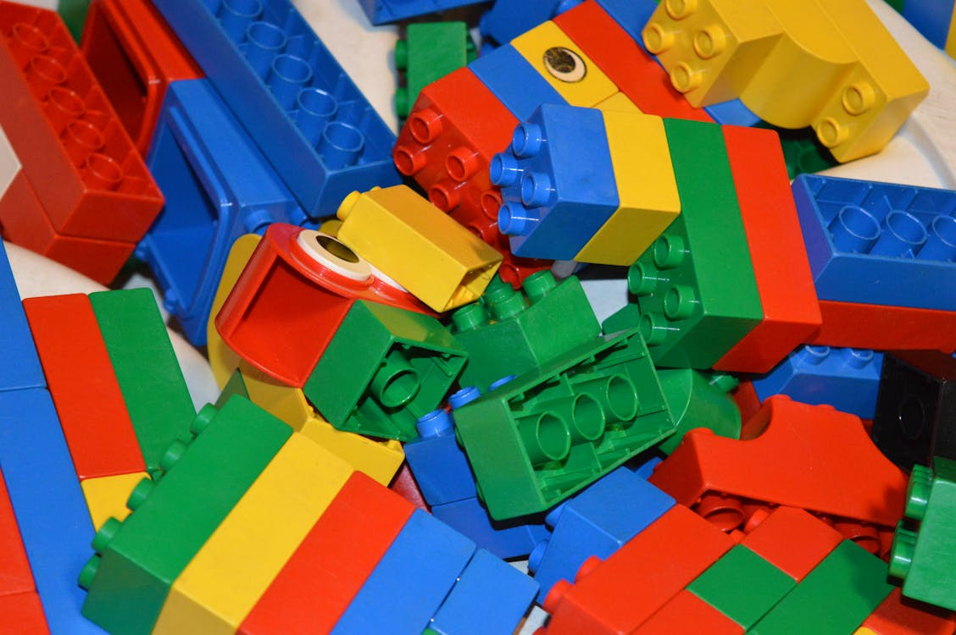
Domains of Functioning (continued)
Attending and completing tasks:
Child should be able to focus on fun activities
Child should be less likely to react to and be distracted by sounds, sights or movements

Slide 23
Domains of Functioning (continued)
Interacting and relating with others:
Child should be developing friendships with other children
Child should be able to speak clearly enough to converse with others
Child should be capable of showing affection to caregivers and others

Slide 24
Domains of Functioning (continued)
Moving about and manipulating objects:
Child should be able to walk and run easily
Child should be able to climb stairs with little supervision
Child should be able to use zippers and other fasteners
Child should be able to put on shoes and other clothing

Slide 25
Domains of Functioning (continued)
Health and physical well-being:
Look for frequent absences from school
Look for physical limitations related to treatment (i.e., fatigue related to medications)
Look for frequent doctor or therapy appointments

Slide 26
Domains of Functioning (continued)
Caring for yourself:
Child should be able to put on shoes and other clothing
Child should be able to understand activities that are unsafe for them
Child should increasingly want to do things by herself

Slide 27
Case Example #1
Avery is a seven-year-old boy with a diagnosis of autism and anxiety. Avery has trouble developing friendships with other children and prefers to be alone. He has frequent behavioral issues at school and has been disciplined for hitting and/or distracting other children in the classroom. Avery must be supervised at all times, or he will run into the street or engage in other unsafe activities. Avery receives assistance from a one-on-one aide at school and spends a portion of his day in a special education classroom. Does Avery have limitations in any domain of functioning? Which domain of functioning?

Slide 28
Case Example #2
Ava is an 11-year-old girl with sickle cell anemia. She has frequent illnesses and hospitalizations and often must be homeschooled to prevent exposure to viruses and infections. Ava is falling behind in her schoolwork and may not be able to advance to sixth-grade next year. Does Ava have limitations in any domain of functioning? Which domain of functioning?

Slide 29
Appeals Process
60-day deadline for filing appeals at each level SSA assumes notices received within 5 days of date on notice.
Can file late for good cause. It is helpful if the doctor can write a letter explaining why Claimant’s condition may have caused him or her to file a late appeal.

Slide 30
Appeals Process (continued)
Levels of Appeal:
Reconsideration – to appeal application decision
Administrative Law Judge (ALJ) Hearing – to appeal Reconsideration
Appeals Council Review – to appeal ALJ decision
Federal Court

Slide 31
Periodic Review of Eligibility and Cessation
Continuing Disability Reviews for Children's SSI Cases
Any child who receives SSI disability benefits will have their eligibility reviewed at least once every three years.
At age 18 – the child’s eligibility is reviewed using adult SSI standards.
The CDR process for children occurs as follows:

Slide 32
Periodic Review of Eligibility and Cessation (continued)
STEP ONE: Has there has been medical improvement in the child's impairments? SSA defines medical improvement as any decrease in the medical severity of [the] impairment(s) which was present at the time of the most recent favorable decision . . .20 CFR 416.994a(c). If there has been NO medical improvement, the child is still disabled and entitled to benefits. If there has been medical improvement, go to STEP TWO.

Slide 33
Periodic Review of Eligibility and Cessation (continued)
STEP TWO: If there has been medical improvement, SSA determines whether the impairment(s) the child had at the time of SSA's most recent favorable decision NOW meets or medically or functionally equals the severity of the listing it met at that time. If the current impairment(s) still meets or equals the original listing, the child remains disabled and benefits will continue. If there has been medical improvement and the child's impairment(s) no longer meets the listing that it met at the time of the last favorable decision, go on to STEP THREE.

Slide 34
Periodic Review of Eligibility and Cessation (continued)
STEP THREE: SSA must consider whether the child's impairment(s) is disabling under the new childhood disability standard, as it appears at 20 CFR 416.924. If the child's impairment(s) falls within the new childhood disability standard, disability benefits will continue. If it does not, disability will cease. In determining whether a child is currently disabled at STEP THREE, SSA conducts the following review:

Slide 35
Periodic Review of Eligibility and Cessation (continued)
Does the child have a severe impairment? If yes, go on to next step. If no, the child is not disabled.
Does the child's impairment(s) meet or equal any of the current listed impairments? If yes, the child remains disabled. If no, go on to next step.
Does the child's impairment functionally equal the severity of any listed impairment? If yes, the child is remains disabled. If no, the child is not disabled.
NOTE: There are a few exceptions in which disability may end, even if there has been no medical improvement. Advocates should review the regulations at 20 CFR 416.994a(e) and (f).

Slide 36
Rights upon Cessation
Notice
Reconsideration
Hearing

Slide 37
Questions?

Slide 38
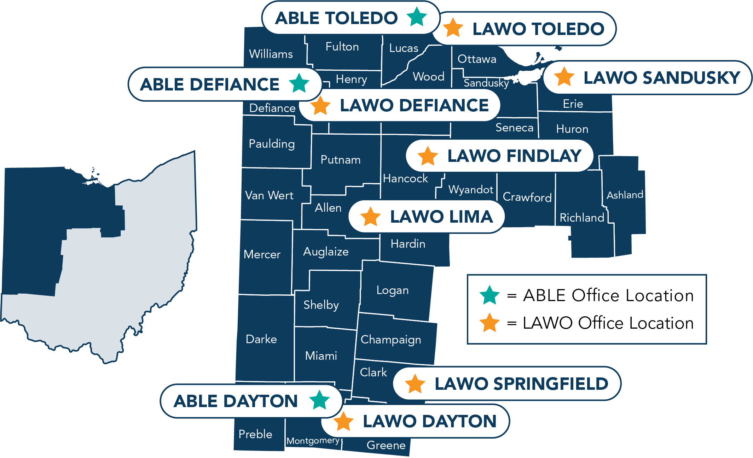
ABLE & LAWO Service Areas
ABLE and LAWO serve low-income people in 32 western Ohio counties.
ABLE offices are in Dayton, Defiance, and Toledo.
LAWO offices are in Dayton, Defiance, Findlay, Lima, Sandusky, Springfield, and Toledo.

Slide 39
Contact Info
Rebecca J. Steinhauser
Managing Attorney
Advocates For Basic Legal Equality
1105 Ralston Ave, Suite A
Defiance, OH 43512
rsteinhauser@ablelaw.org
419-930-2494

