Slide 1
OhioRISE (Resilience through Integrated Systems and Excellence) Overview

Slide 2
Supporting Youth and Families Across Systems
Keeping families together.
Reducing custody relinquishment for children, youth, and families.
Reducing unnecessary hospitalizations and emergency department visits.
Decreasing involvement with the juvenile justice and corrections systems.
Reducing out-of-home and out-of-state placements.
Increasing school attendance and performance.
Youth and Families
Multisystem Youth
Hospital System
Justice System
Child Protection and Developmental Disability Systems
Education System
Notes:
Speaker Notes:
The OhioRISE program aims to support multisystem youth, these are youth with behavioral health needs who are also receiving services and supports from other local child-serving systems. OhioRISE’s services and care coordination can help youth and families and other system partners’ goals in the following ways (review slide).

Slide 3
OhioRISE New and Improved Services
Limited, Moderate, and Intensive Care Coordination
Existing Behavioral Health Services
Primary Flex Funds
Mobile Response and Stabilization Services (MRSS)
Psychiatric Residential Treatment Facility (PRTF)
Intensive Home-Based Treatment (IHBT)
Behavioral Health Respite
Also available through Medicaid managed care organizations and fee-for-service Medicaid.
*Youth in OhioRISE have their behavioral health benefits covered by Aetna Better Health of Ohio, the OhioRISE plan. Their physical health benefits covered by their current managed care organization or fee-for-service Medicaid.
Notes:
Tags: text, considerations

Slide 4
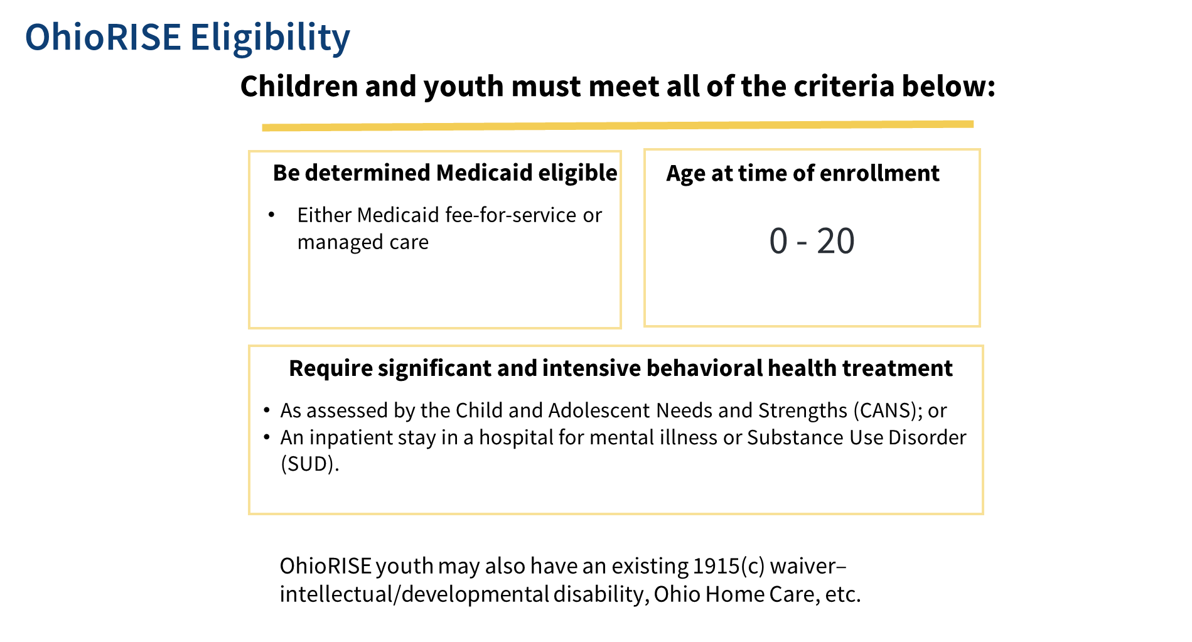

Slide 5
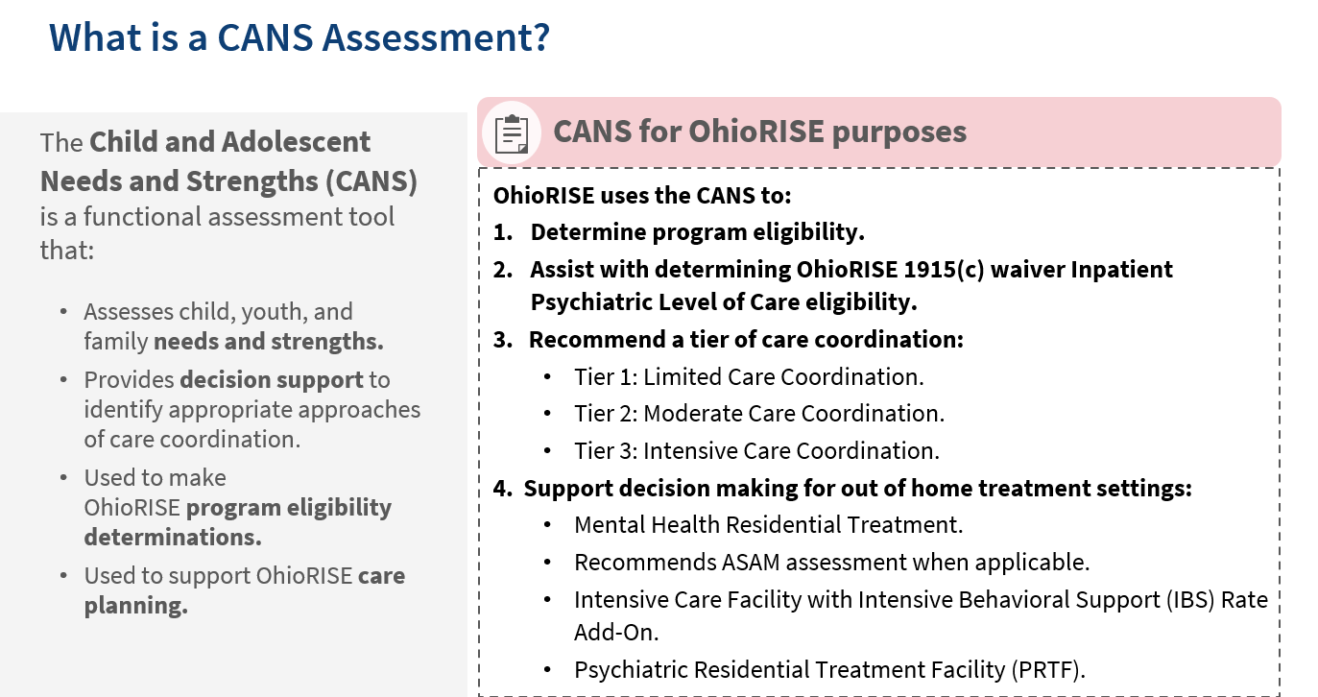
Notes:
Speaker Notes:
The Child and Adolescent Needs and Strengths (CANS) is a functional assessment tool that:
Assesses both child and family needs and strengths
Provides decision support to help identify approaches that address youth and family needs while building on their strengths
Is Used to make OhioRISE eligibility determinations
Is Used to support OhioRISE care planning
Brief CANS
Used as an “initial” assessment
Includes core items – the minimum elements necessary to determine:
OhioRISE eligibility
OhioRISE recommended tier of care coordination
QRTP level of care
Recommendations for care
Comprehensive CANS
Used for “ongoing” assessment –expands items in brief to improve care planning and coordination
Could be used at time of initial assessment if preferred by assessor
Additional modules are triggered by responses on specific items –ex. Sexually problematic behavior module, runaway module
1915c eligibility
–ex. Sexually problematic behavior module, runaway module are triggered if those items are indicated as a need –drives the assessor/team to take a deeper dive into areas of concerns that likely need a little more attention and further assessment/planning

Slide 6
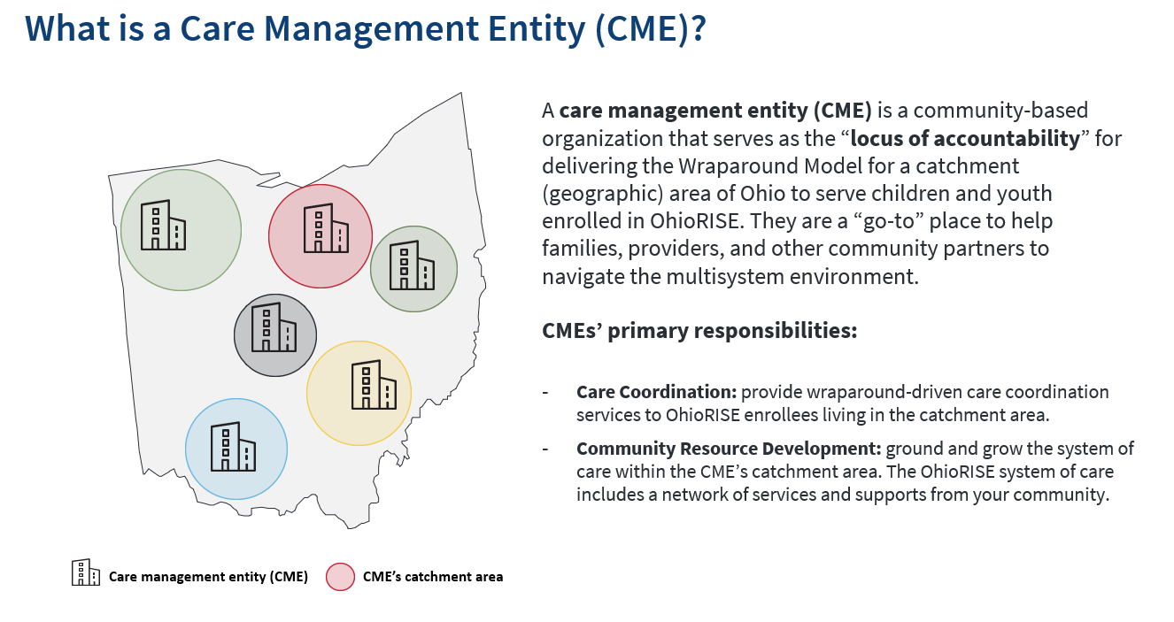

Slide 7
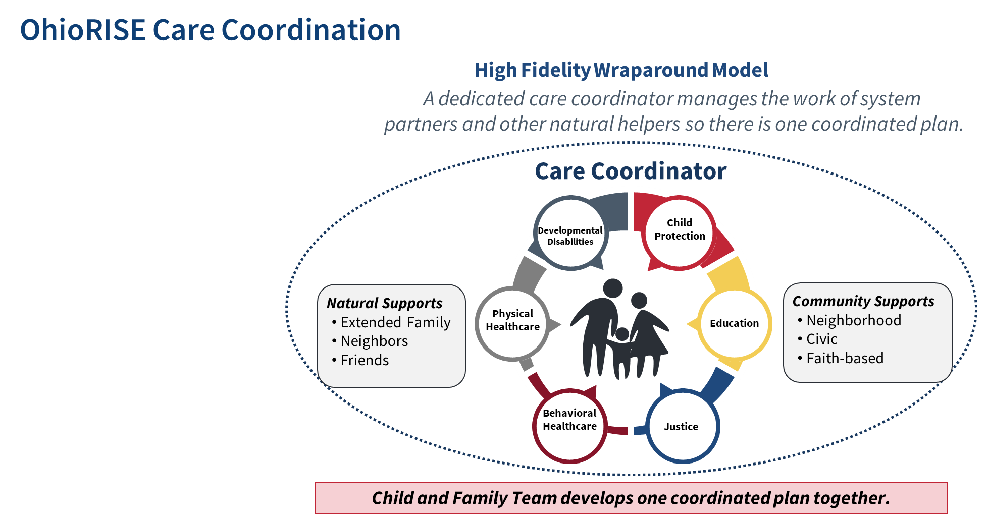
Immediate access to care coordination to assist with accessing services and supports.
Deep dive into what kids and families need, based on each child/youth’s CANS and use of the wraparound process.
It's a team of teachers, providers, advocates, school counselors, and other community partners to help the youth.

Slide 8
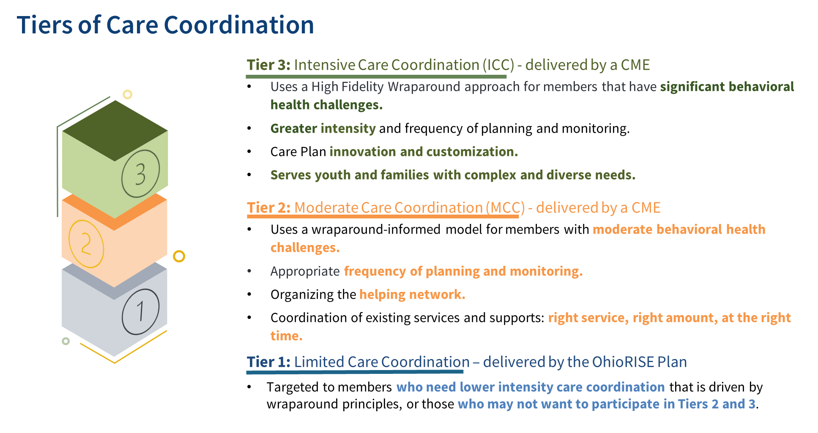

Slide 9
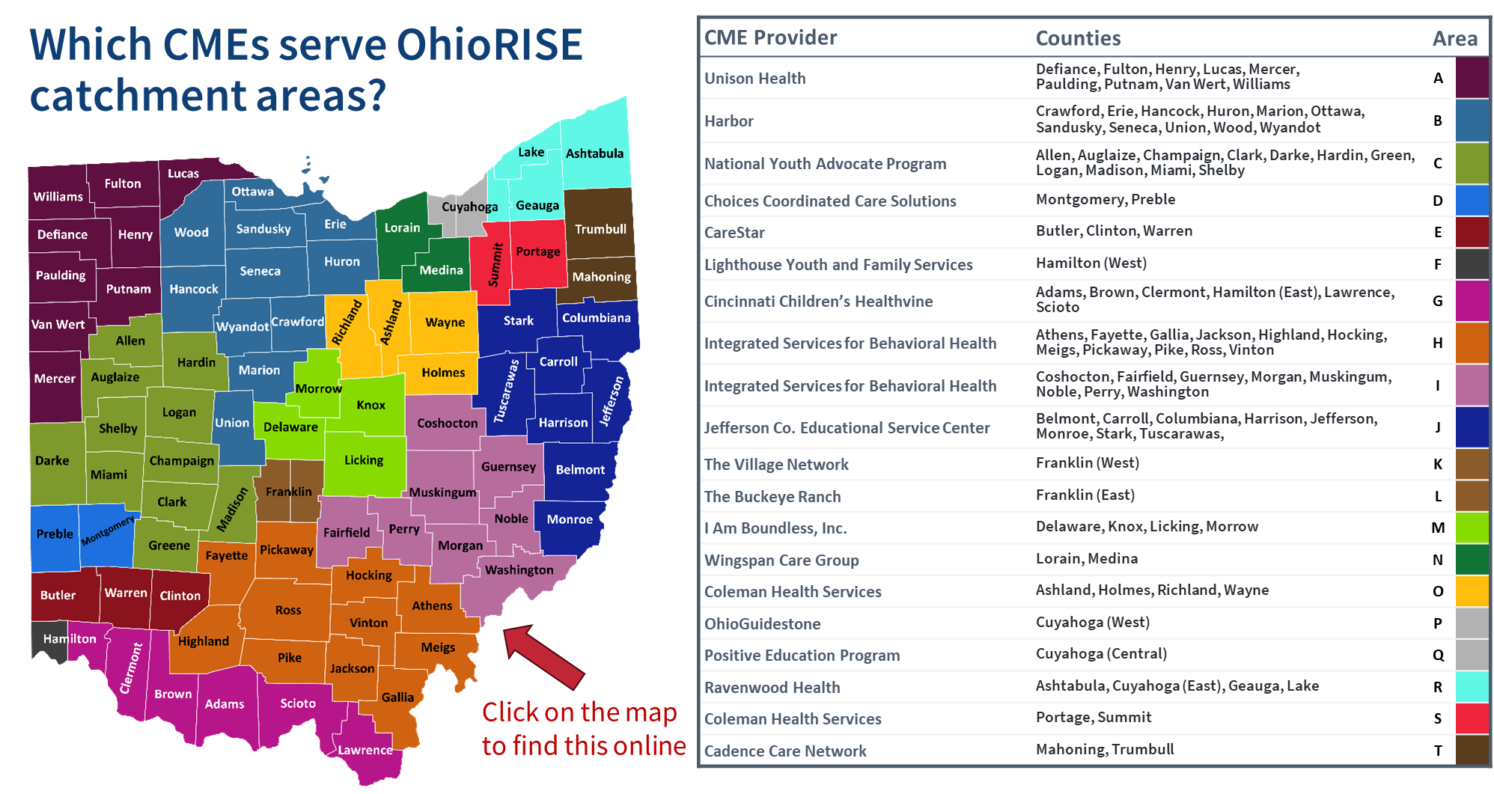

Slide 10
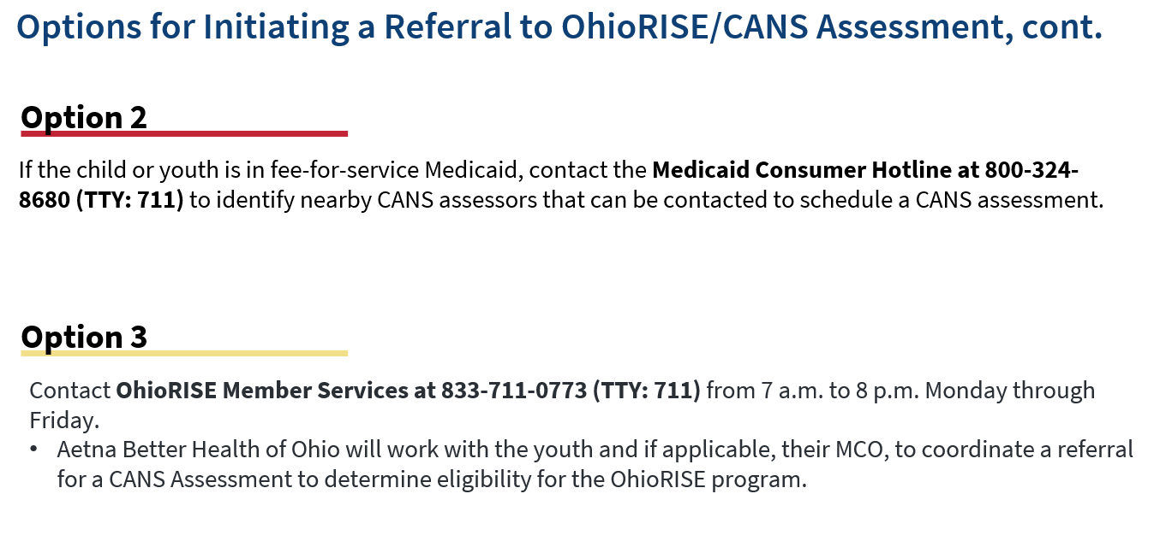

Slide 11
stephan.cooke@aetna.com

